Slide 1

Commitment to Equity: a Primer
Nora Lustig
Tulane University
Fiscal Policy for an Equitable Society
CEQ Global Project
PREM-World Bank and Tulane University
Kick-off Workshop
Washington, DC – June 11, 2013

Slide 2
Overview of CEQ Work and Results
What is the Commitment to Equity (CEQ) assessment?
Where? Countries covered
Who? Organizational structure, participating countries, teams, funders

Slide 3
What is CEQ?
CEQ assessments use incidence analysis and a specially-designed diagnostic questionnaire to:
  assess how aligned public spending and taxation are with supporting a minimum living standard and with reducing ‘post-fisc’ inequality
  inform governments of how their tax policy and public spending affects their equity goals
  recommend practical measures to--within the limits of fiscal prudence– make taxes and transfers more pro-poor
  enhance accountability and transparency through better data collection and evaluation systems

Slide 4
What is CEQ?
  CEQ can provide a roadmap for governments, multilateral institutions, and nongovernmental organizations in their efforts to build more equitable societies

Slide 5
Who? Organizational Structure
CEQ Latin America: CIPR and Dept. of Economics at Tulane University and Inter-American Dialogue
Directors: Nora Lustig and Peter Hakim
Network of authors of country studies
Technical Coordinator: Sean Higgins

Slide 6
Who? Authors (completed; WP available)
Argentina: Nora Lustig and Carola Pessino
Bolivia: George Gray Molina, Wilson Jimenez, Veronica Paz and Ernesto Yañez
Brazil: Sean Higgins and Claudiney Pereira
Colombia (tax returns): Facundo Alvaredo and Juliana Londoño
Mexico: John Scott; over time: JS and Lopez-Calva, Lustig and Castañeda
Peru: Miguel Jaramillo
Uruguay: Marisa Bucheli, Nora Lustig, Maximo Rossi and Florencia Amabile

Slide 7
Who? Authors (almost completed)
Chile: Dante Contreras and Jaime Ruiz-Tagle
Colombia (HH survey): Carlos Hurtado, Nora Lustig and Marcela Melendez
Costa Rica: Pablo Sauma and Juan Diego Trejos
El Salvador: Margarita Beneke, Nora Lustig and José Andrés Oliva
Guatemala: Maynor Cabrera, Nora Lustig e Hilcías Morán
Paraguay: Sean Higgins, Nora Lustig, Julio Ramírez and William Swanson

Slide 8
Who? Financial Support
Canadian International Development Agency (CIDA)– initial stage and three pilot countries
Center for Inter-American Policy and Research at Tulane University (CIPR) – main funder in implementation stage
Inter-American Development Bank (IDB)--race and ethnicity
International Fund for Agricultural Development (IFAD)--rural urban
Latin American Development Bank (CAF)--background paper for flagship report
United Nations Development Program (UNDP)– first meeting of Adv Board and workshop; synthesis; Colombia (top incomes), update Peru, upcoming: Ecuador (top incomes), Nicaragua and Venezuela
World Bank – background paper for mobility report; Mexico Social Spending 1992-2010; upcoming: DR, Ecuador, Panama; policy briefs: Col, Mx and Par;

Slide 9
Where? Countries
Currently: 12 countries from Latin America; one ‘local’ team per country
7 finished: Argentina (2003, 2006, 2009), Bolivia (2007), Brazil (2009), Colombia (Tax Returns), Mexico (2008, 2010; 1992-2010), Peru (2009), Uruguay (2009)
6 in progress: Chile, Colombia, Costa Rica, El Salvador, Guatemala, Paraguay
Upcoming: Dominican Republic, Ecuador, Honduras, Nicaragua, Panama, United States and Venezuela

Slide 10
Outputs
Methodology: Handbook/Master Workbook & Diagnostic Questionnaire; Measuring Impoverishment
CEQ Assessments (master workbooks) for whole population: 6 completed and 6 almost completed; 5 rural-urban; 4 ethnicity and race; 1 top incomes
Chapter for Asian Development Bank publication
Background papers and reports

Slide 11
Outputs
15 CEQ Working Papers
World Bank working papers (Uruguay; Paraguay in progress)
Forthcoming special issue of Public Finance Review, edited by Nora Lustig, Carola Pessino and John Scott
In 2014, edited volume with 12 LA cases

Slide 12
CEQ WORKING PAPER SERIES
Commitment to Equity Assessment (CEQ): Estimating the Incidence of Social Spending, Subsidies and Taxes. Handbook, by Nora Lustig and Sean Higgins, CEQ Working Paper No. 1, July 2011; revised January 2013.
Commitment to Equity: Diagnostic Questionnaire, by Nora Lustig, CEQ Working Paper No. 2, 2010; revised August 2012.
The Impact of Taxes and Social Spending on Inequality and Poverty in Argentina, Bolivia,Brazil, Mexico and Peru: A Synthesis of Results, by Nora Lustig, George Gray Molina, Sean Higgins, Miguel Jaramillo, Wilson Jiménez, Veronica Paz, Claudiney Pereira, Carola Pessino, John Scott, and Ernesto Yañez, CEQ Working Paper No. 3, August 2012.
Fiscal Incidence, Fiscal Mobility and the Poor: A New Approach, by Nora Lustig and Sean Higgins, CEQ Working Paper No. 4, September 2012.
Social Spending and Income Redistribution in Argentina in the 2000s: the Rising Role of Noncontributory Pensions, by Nora Lustig and Carola Pessino, CEQ Working Paper No. 5, January 2013.
Explaining Low Redistributive Impact in Bolivia, by Verónica Paz Arauco, George Gray Molina, Wilson Jiménez Pozo, and Ernesto Yáñez Aguilar, CEQ Working Paper No. 6, January 2013.

Slide 13
Social Spending and Income Redistribution in Argentina in the 2000s: the Rising Role of Noncontributory Pensions, by Nora Lustig and Carola Pessino, CEQ Working Paper No. 5, January 2013.
Explaining Low Redistributive Impact in Bolivia, by Verónica Paz Arauco, George Gray Molina, Wilson Jiménez Pozo, and Ernesto Yáñez Aguilar, CEQ Working Paper No. 6, January 2013.
The Effects of Brazil’s High Taxation and Social Spending on the Distribution of Household Income, by Sean Higgins and Claudiney Pereira, CEQ Working Paper No.7, January 2013.
Redistributive Impact and Efficiency of Mexico’s Fiscal System, by John Scott, CEQ Working Paper No. 8, January 2013.
The Incidence of Social Spending and Taxes in Peru, by Miguel Jaramillo Baanante, CEQ Working Paper No. 9, January 2013.
Social Spending, Taxes, and Income Redistribution in Uruguay, by Marisa Bucheli, Nora Lustig, Máximo Rossi and Florencia Amábile, CEQ Working Paper No. 10, January 2013.
Social Spending, Taxes and Income Redistribution in Paraguay, Sean Higgins, Nora Lustig, Julio Ramirez, Billy Swanson, CEQ Working Paper No. 11, February 2013.High Incomes and Personal Taxation in a Developing Economy: Colombia 1993-2010, by Facundo Alvaredo and Juliana Londoño Vélez, CEQ Working Paper No. 12, March 2013.
The Impact of Taxes and Social Spending on Inequality and Poverty in Argentina, Bolivia, Brazil, Mexico, Peru and Uruguay: An Overview, Nora Lustig, Carola Pessino and John Scott, CEQ Working Paper No. 13, April 2013.
“Measuring Impoverishment: An Overlooked Dimension of Fiscal Incidence, by Sean Higgins and Nora Lustig, CEQ Working Paper No. 14, April 2013
“Tax Reform in Latin America: A long term assessment,” by Vito Tanzi, CEQ Working Paper No. 15, April 2013

Slide 14
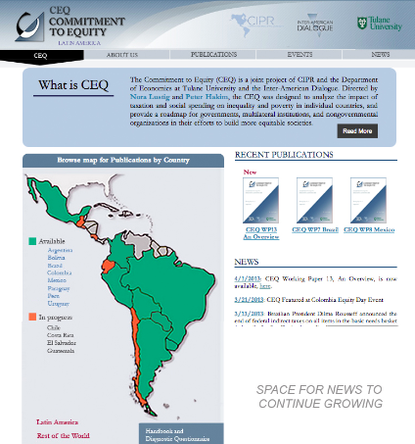
www.commitmentoequity.org

Slide 15
CEQ: From Latin America to “Global”
Project led by Gabriela Inchauste, Senior Economist, Poverty Reduction and Equity Dept., WB
Pilot studies: Country/Lead Researcher
  Armenia: Stephen Younger, Cornell University
  Ethiopia: Tassew Woldehanna, Addis Ababa Univ.
  Indonesia: Jon Jellema, World Bank
  Jordan: Paolo Verme, World Bank
  South Africa: Ingrid Woolard, Univ. of Capetown
  Sri Lanka: Nisha Arunatilake, Inst. of Policy Studies

Slide 16
Commitment to Equity Assessments (CEQ) for Latin America
Comprehensive, standard fiscal incidence analysis of current systems
Standardizes definitions and methodological approaches to facilitate cross-country comparisons
Uses income per capita as the welfare indicator
Data: mainly household surveys; two studies with tax returns data
Allocators vary => full transparency in the method used for each category, tax shifting assumptions, etc.
No behaviorial and no general equilibrium effects
Mainly average incidence; a few cases with marginal incidence

Slide 17
Basic elements of “applied” standard incidence (from Jim Alm, May 2012)
Pre-tax/pre-transfer income/consumption of unit h, or I_{h}
Taxes/transfers programs T_{i}
“Allocators” of program i to unit h, or S_{ih} (or the share of program i borne by unit h)
Then, post-tax/post-transfer income of unit h, or Y_{h} is:
Y_{h} = I_{h} - ∑_{i} T_{i}S_{ih}

Slide 18
Standard Fiscal Incidence Analysis
Pre-tax and benefits incomes
Allocators of taxes and benefits
  personal income and consumption taxes
  social spending: cash transfers and in-kind transfers (education and health)
  consumption subsidies
Post-tax and benefits incomes
What about: corporate income taxes, tariffs and export taxes/subsidies, indirect effect of production taxes/subsidies, other in-kind transfers (infrastructure)

Slide 20
Welfare Indicators
Income vs. consumption; consumption equivalent to disposable income?
Monetary or total (autoconsumption and imputed rent)
Current vs. Lifetime
Per capita vs. equivalized
From market to net market or to gross income?
Which concept/s should one use?

Slide 21
Contributory Pensions
Government transfer or market income?
  No agreement in literature for pay as you go systems
CEQ Benchmark
  Contributory pensions are part of market income
  Contributions to pensions are not subtracted
CEQ Sensitivity Analysis
  Contributory pensions are a government transfer
  Contributions to pensions are subtracted like tax
  Should one test other assumptions?

Slide 22
Imputing Rent
Direct identification
Opportunity cost approach (hedonic regressions)
  Sometimes no info on dwelling exists
Capital market approach -- Overestimates
Self-assessment --Overestimates
The “ten percent” of Monetary Income approach
  Socio-economic Database for LAC (SEDLAC); CEDLAS/Universidad de La Plata and World Bank
Which method should one use in the absence of data in survey?

Slide 23
Allocation Methods
Direct Identification in microdata
If not in microdata, then:
  (micro) Simulation: statutory vs. tax shifting, coverage/take-up assumptions
  Imputation
  Inference
  Alternate Survey
  Secondary Sources
  How problematic is it to mix methods? (comprehensive studies more often than not mix different methods)

Slide 24
Allocation Methods
Tax shifting assumptions
Tax evasion assumptions
Coverage/Take-up of cash transfers programs
Monetizing in-kind transfers

Slide 25
Tax Shifting and Tax Evasion Assumptions
Burden of direct personal income taxes is borne by the recipient of income
Burden of payroll and social security taxes falls entirely on workers
Consumption taxes are assumed to be shifted forward to consumers
Individuals who do not participate in the contributory social security system assumed not to pay income or payroll taxes
Depending on the country, purchases in informal sector establishments or in rural areas assumed not to pay consumption taxes
Should one do sensitivity analyses to these assumptions?

Slide 26
Valuation of Public Services: Education and Health
Valuation of public spending on education and health follows the so-called ‘government cost’ approach.
Uses per beneficiary input costs obtained from administrative data as the measure of marginal benefits.
This approach—also known as ‘classic’ or ‘nonbehavioral approach’—amounts to asking the following question: how much would the income of a household have to be increased if it had to pay for the free or subsidized public service at full cost?
Which other methods should one try? How can one take into account differences in quality of services?

Slide 27
Scaling-Up to Monetize Transfers In Kind
Household surveys understate “true” income
  Underreporting
  Lack of adequate questions
  Society’s richest not captured by survey
HOWEVER, No scaling up for poverty measures (no corrections for under-reporting)
Scaling up for inequality and distributional measures to avoid overstating impact of in-kind transfers
Should one abandon the idea of monetizing in-kind transfers? If not, how should one make sure scaling-up is done properly?

Slide 28
Sensitivity Analyses
Contributory pensions as market income and government transfer
With and without scaling-up; types of scaling up to take into account waste and corruption
Statutory vs. alternative assumptions of tax compliance and program compliance (imputation of benefits and beneficiaries)
In-kind transfers: how do you value them to take into account waste and corruption and the value for households
Evasion assumptions, especially of VAT/sales taxes
Which sensitivity analyses should be done by all studies?

Slide 29
Indicators
Inequality and poverty (all the usual ones)=> anonymous. We don’t know where individuals were in the pre-fisc distribution
Winners and losers: Incidence by decile/quintile; horizontal equity; fiscal mobility. We do care where individuals were in the pre-fisc distribution
Progressivity: concentration shares and concentration coefficients; Kakwani; Reynolds-Smolensky

Slide 30
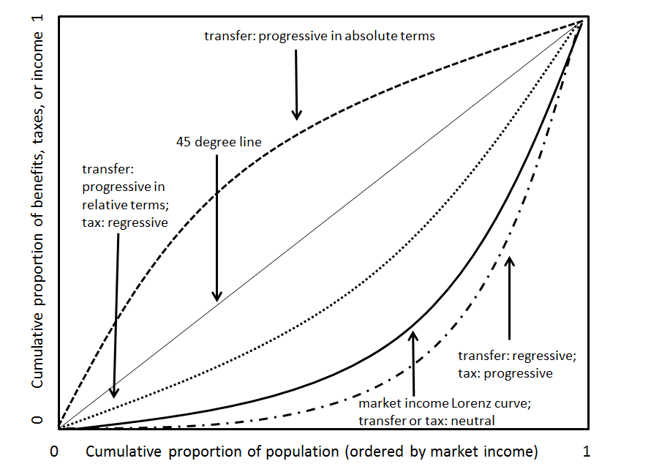
Defining Progressive/Regressive
Taxes and Transfers

Slide 31
Indicators
Contribution of specific taxes and transfers to equity outcomes
Effectiveness
Efficiency

Slide 32
THANK YOU

